Slide 1
Cyber Security @SWCA
Greg McClelland And Amy ScHaKAT

Slide 2

Curriculum / Course of Study
Cyber Security Courses
Junior Year Periods 1-3
Networking 145035
Cyber Security 146005
Senior Year Periods 6,7,8
Cyber Security Defense and Reinforcement 146010
Cyber Security Testing and Response 146015

Slide 3

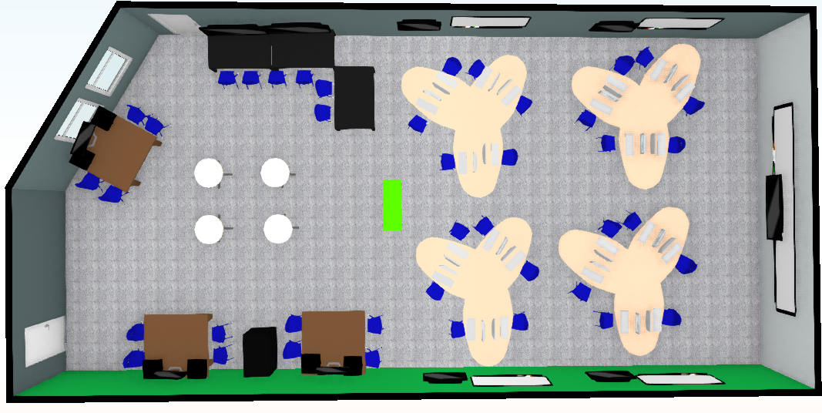
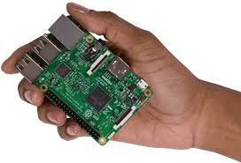
The Beginnings
Took over the Program in 2017
  PLTW Trained in Computer Science
  History Teacher for 15 Years
Class Sizes range from 14 – 20 (MAX is 24)
Dedicated Lab Space and Classroom Space
  Focus on Networking, Programming(JAVA, Python, Linux)
  Packet Tracer(CISCO, Marcraft Industries)
  IoT Devices (Arduino, Raspberry Pi)

Slide 4
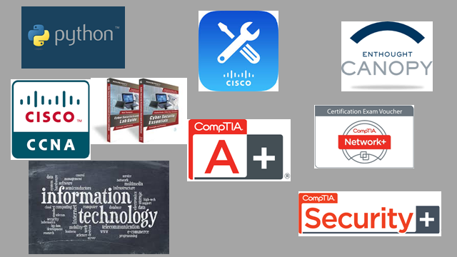
Certifications

Slide 5
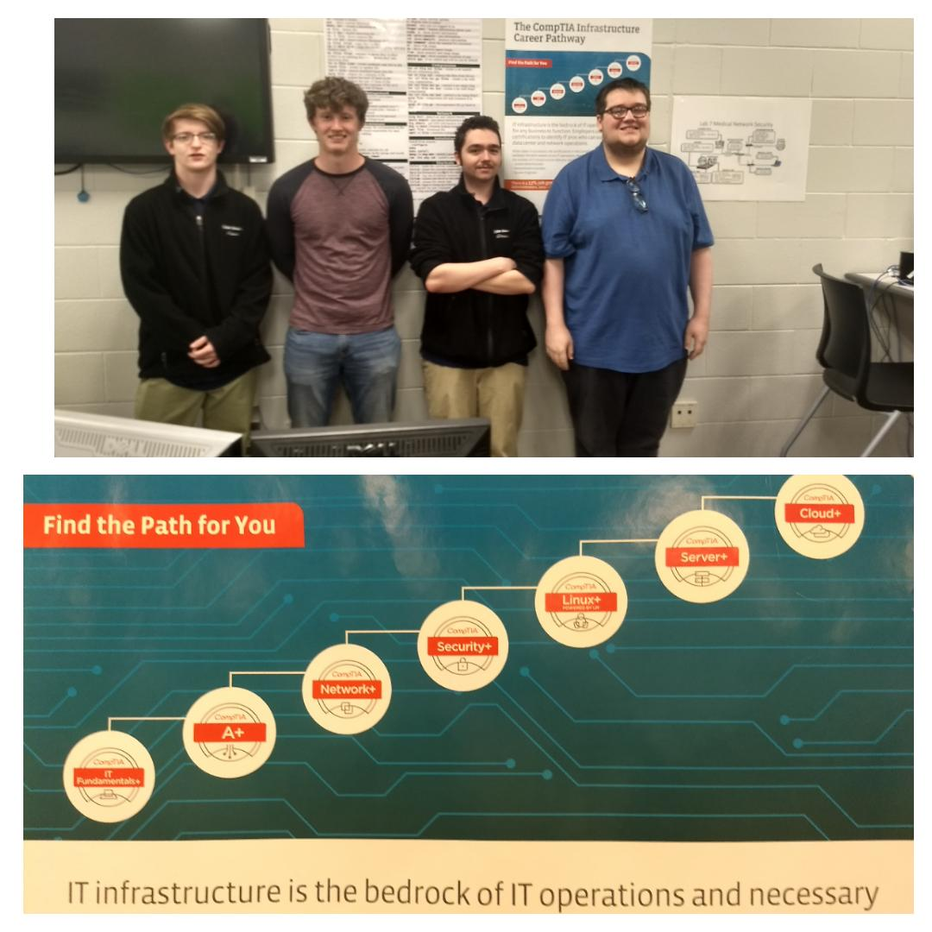

Slide 6





Internships

Slide 7
INITIAL PLANS
6-8 Week Internship
4-6 students participating
Potential growth moving into 2019-2020
  UPDATE: Ohio Health Took 6 Students in 2020
Students would have idea of specific area before entering into internship
  Networking
  Incident Risk Management
  Access Identity Management
  Defense and Reinforcement

Slide 8
Reality and Effects
Teacher failure to prepare students for necessities of internships
  Driving
  Schedule conflicts
  Willingness of students to step outside comfort zone
2 of the 4 students on internship passed Security +
They all acknowledged it was a good experience
They all acknowledged it was harder than a typical school day
They all believe it was beneficial for their career plans

Slide 9
New to 2020
Used Connections within these companies to begin having conversations
Shared core curriculum and invited for room observations

Slide 10
Final Goals
Produce 10 more Security+ certified Students
Bring in Ohio Means Jobs as partner for graduating students
Move IT Fundamentals to Junior year and Add Network + to Senior year with Security +
Find areas of Workforce development
  They are still 18 when they leave me and need continued guidance
    Ohio Means Jobs
    Goodwill

